Slide 1

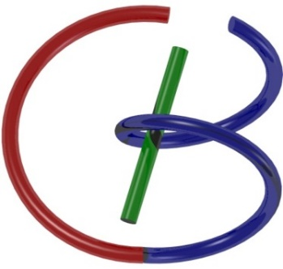

CT Reconstruction – Cone-beam: Exact
Ge Wang
AI-based X-ray Imaging System (AXIS) Lab
Rensselaer Polytechnic Institute, Troy, New York, USA
September 15, 2023

Slide 2
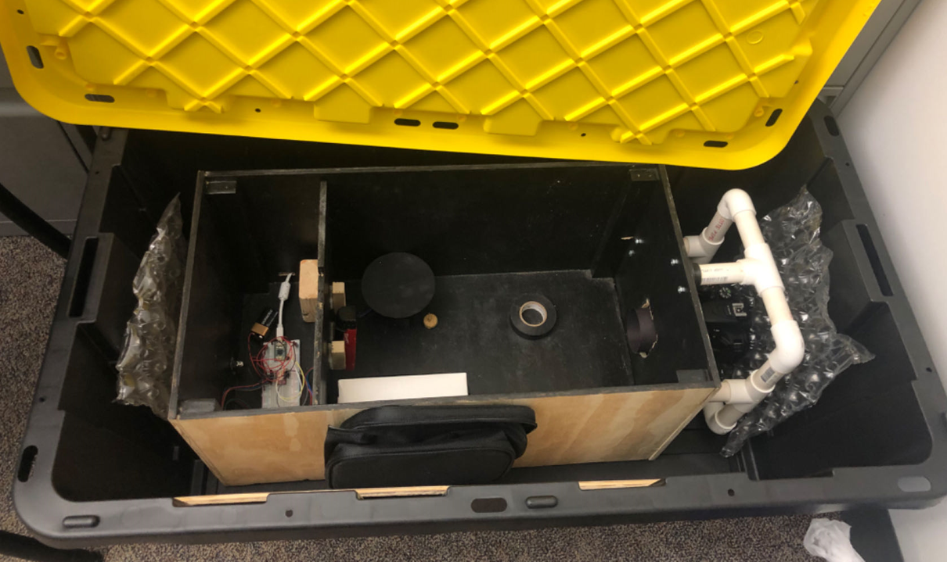
Optical CT Project

Slide 3
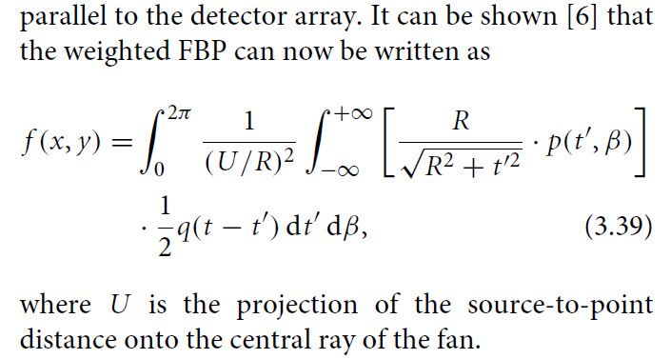
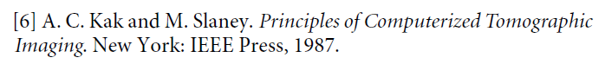
Equi-spatial Fan-beam Formula
Wang, Lin, Cheng: IEEE TIP 2:543-547, 1993

Slide 4
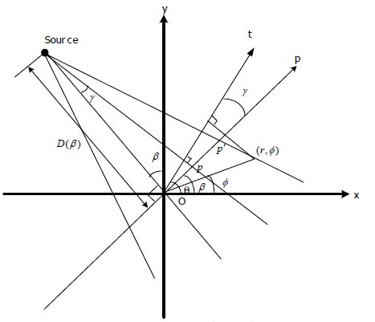
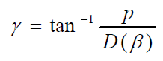
Hint: Where is the Error?

Slide 5
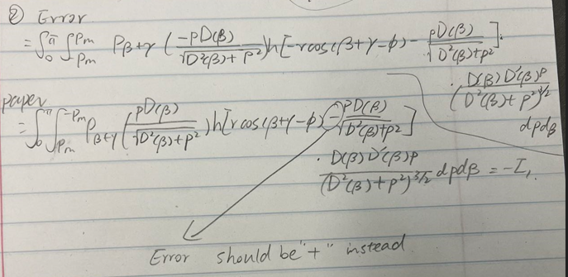
Where is the Error?

Slide 6
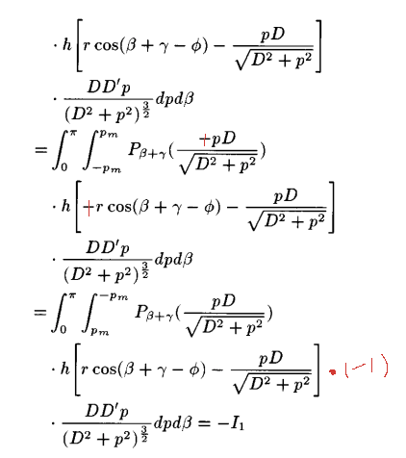
Where is the Error?

Slide 7
Peeling a 2D Onion
A tangent ray touches only one point, hence the peripheral shell can be directly measured
Layer by layer the disk image can be recovered

Slide 8
Probing Waves
No any info in projection data along non-orthogonal directions
Info in projection data along the orthogonal direction

Slide 9
Outline
Recon with 2D Planar or 2D Parallel-beam Data
Peeling a 3D Onion
Two Fourier Slice Theorems in 3D
Orlov Condition
Conversion between Planar & Parallel-beam Data
Recon with Cone-beam Data
Difficulty with Beam Divergence
Grangeat Relationship

Slide 10
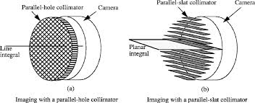
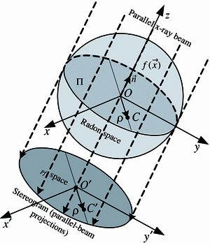
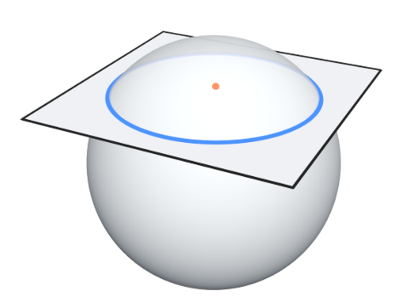
Planar & 2D Parallel-beam Data

Slide 11
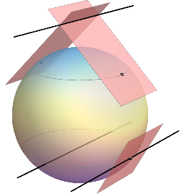
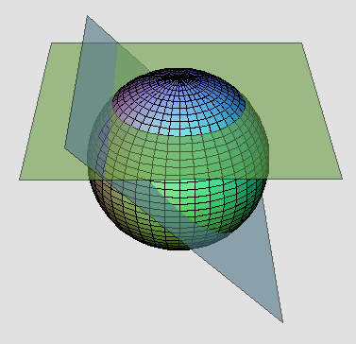
Peeling a 3D Onion

Slide 12
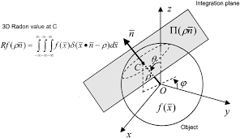
1st Format: Planar Integral (2D)

Slide 13
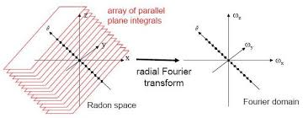
First Slice Theorem in 3D
(Direction, Distance)

Slide 14
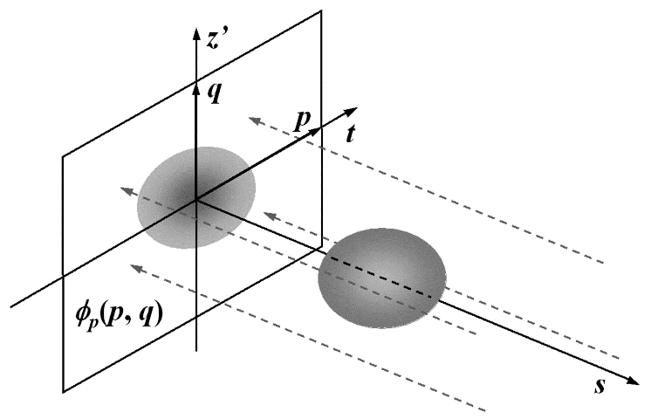
2nd Format: Parallel Projection (2D)

Slide 15
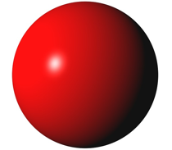

Second Slice Theorem in 3D
3D Fourier Transform
2D Fourier Transform

Slide 16

Half-scan
w
v
O
u
Number of Entering the Front Surface = 1 Or
Number of Entering the Back Surface = 1 for Any 3D Point
Imagine that the normal vector of the green plane y-z turns 180° in the x-y plane…

Slide 17
Wobbling
w
v
O
u
Number of Entering the Front Surface =
Number of Entering the Back Surface for Any 3D Point
Imagine that the normal vector of the green plane y-z wobbles with respect to the origin O but eventually returns to the original location along the x axis…

Slide 18
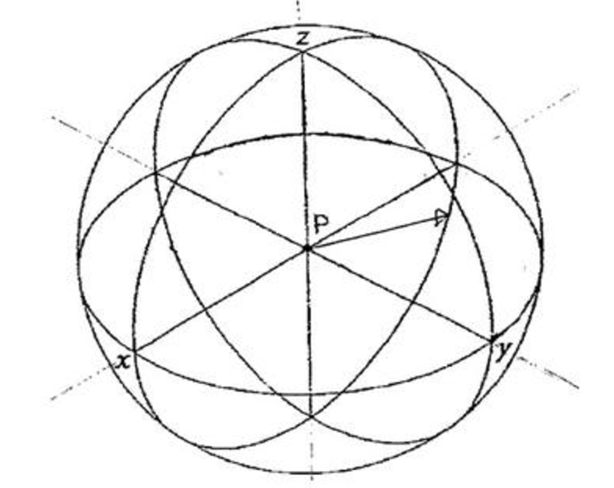
Orlov Condition
A complete dataset can be obtained if every great circle intersects the trajectory of the unit directional vector, which is the direction of the parallel beam of x-rays.
S.S. Orlov, “Theory of three dimensional reconstruction. I. Conditions for a complete set of projections,” Sov. Phys. Crystallogr., vol. 20, no. 3., pp. 312–314, 1975.

Slide 19
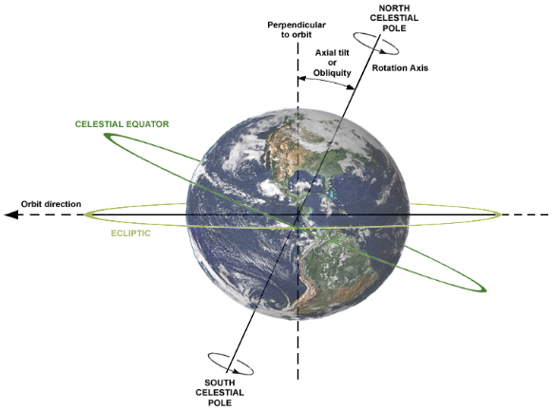
Orlov Scan = Wobbling + Half-scan
The scanning trajectory continuously connects the two ends of a diameter of the unit sphere.
Each Point in the 3D Fourier Space Must Have Been Measured!

Slide 20
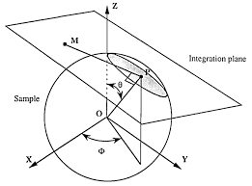
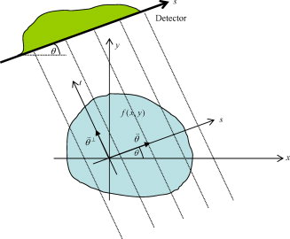
Line Integrals ↔ Planer Integrals
All line integrals to all planar integrals
All planar integrals to all line integrals

Slide 21
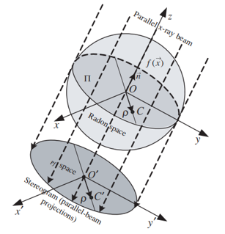
Projection Data to Planar Integral Data
2D parallel-beam projection data can be organized along parallel lines on the 2D projection plane into planer integral data

Slide 22
Projection Data to Planar Integral Data

Slide 23
Planar Integral Data to Projection Data
Each planar integral gives a line integral value for the projected “object” on the x’-y’s plane

Slide 24
Planar Integral Data to Projection Data
Each data point is a planar integral
Each reconstructed image pixel is a line integral
Reconstructed image is a 2D parallel-beam projection on the x’-y’ plane

Slide 25
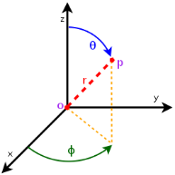

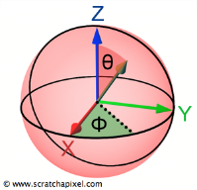

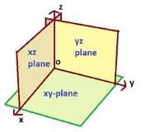
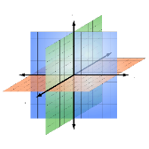
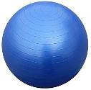

No Redundancy in Planar Integrals

Slide 26
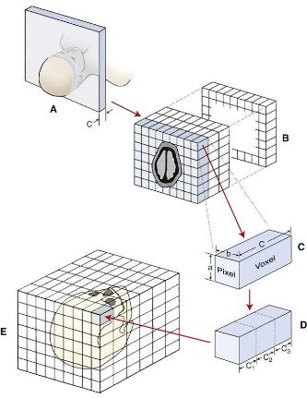
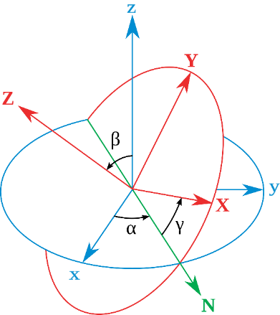
Redundancy in 2D Projections

Slide 27
Outline
Recon with 2D Planar or Parallel-beam Data
Peeling a 3D Onion
Two Fourier Slice Theorems in 3D
Orlov Condition
Conversion between Planar & Parallel-beam Data
Recon with Cone-beam Data
Difficulty with Beam Divergence
Grangeat Relationship

Slide 28
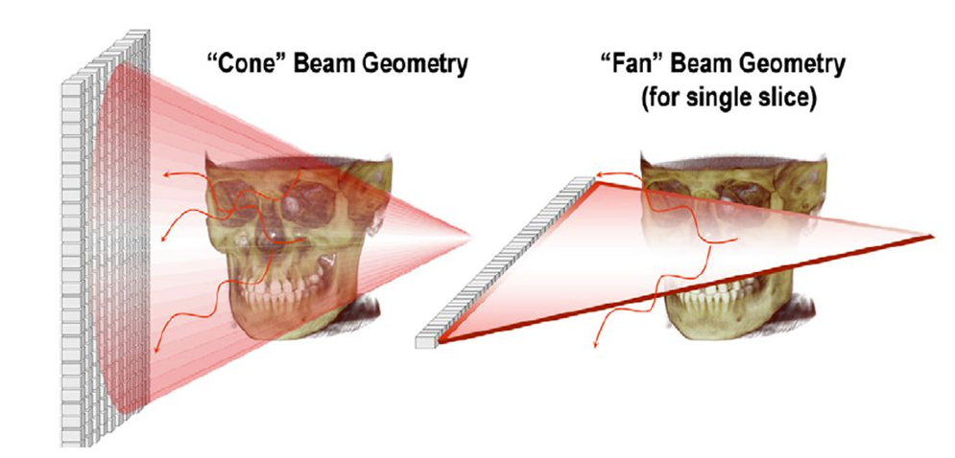
3rd Format: Cone-beam Projection
X-ray
Source
System
Origin

Slide 29
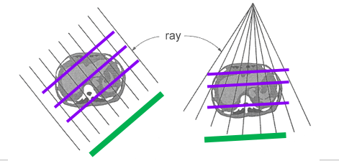
Problem with r
r
X-ray
Source
β
System
Origin
α
p
Vertical plane specified by p(α)
Point in the plane specified by r and β
Find a reference plane (red circle). Then, a vertical plane can be specified by p (α) from the system origin, and any point in the plane can be specified by r and β from the source
We need planer integrals
What we measure is line integrals in a divergent beam

Slide 30
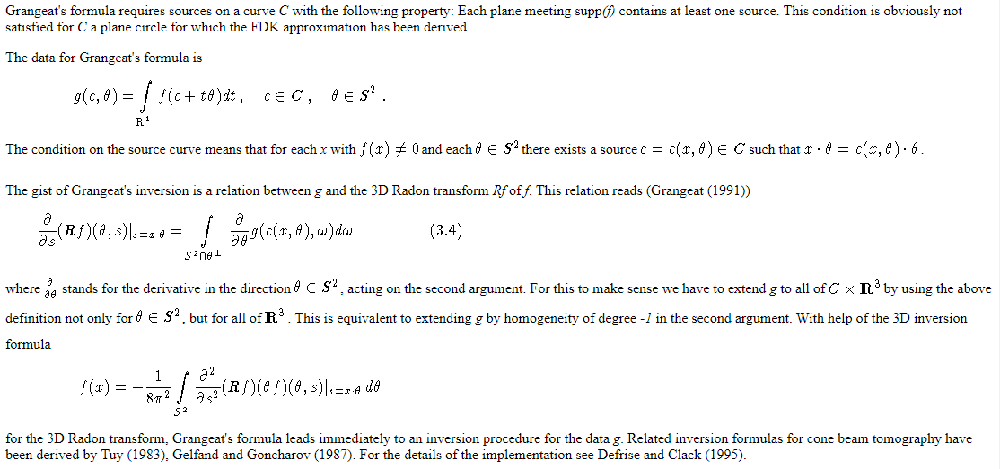
Grangeat Relationship
https://www.uni-muenster.de/AMM/num/Preprints/1998/natterer_1/paper.html/node16.html
https://link.springer.com/chapter/10.1007/BFb0084509

Slide 31
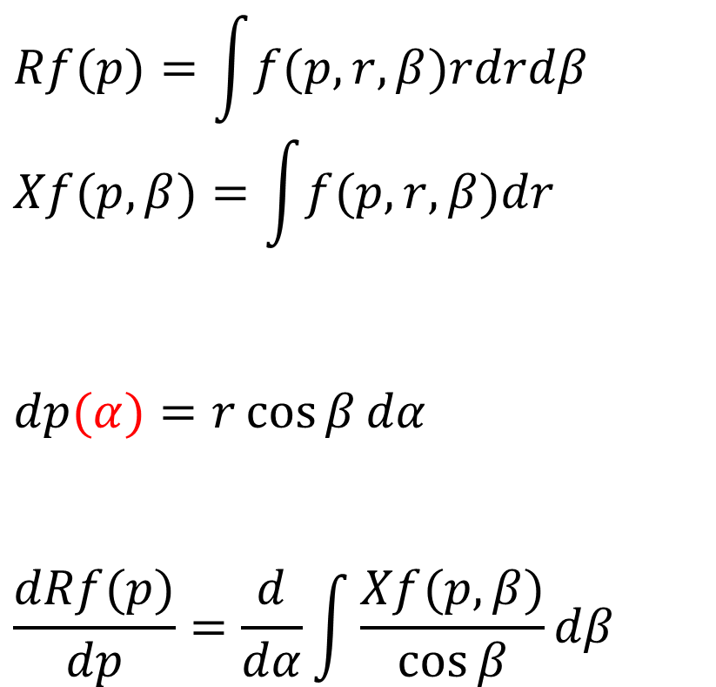
From Cone-beam to Planar Data
What we need is parallel-beam or planer data
$$Rf(p)=\int{f(p,r,β)rdrdβ} \\ Xf(p,β)=\int{f(p,r,β)dr}$$
$$dp(α)=r\cos{β}dα$$
$$\frac{dRf(p)}{dp}=\frac{d}{dα}\int{\frac{Xf(p,β)}{\cos{β}}}dβ$$
What we measure is line integrals in a divergent beam
r
X-ray
Source
β
System
Origin
α
p
Find a reference plane (red circle). Then, a vertical plane can be specified by p (α) from the system origin, and any point in the plane can be specified by r and β from the source

Slide 32
Measured Spherical Surface (Diameter=D)
D
Source
Origin

Slide 33
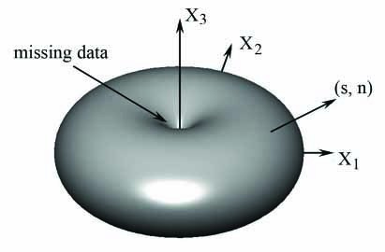
Measured & Missing Radon Data

Slide 34
Data Sufficiency in 2D
There exists at least a source on any line
intersecting a cross-section
These represent the maximum amount of data you can measure, which are sufficient

Slide 35
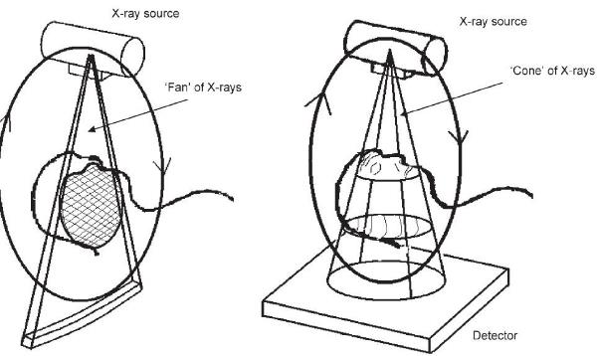
Data Sufficiency in 2D
At least a point on a source orbiton any line in an object

Slide 36
Data Sufficiency in 3D
At least a point on a source orbit on any plane in an object

Slide 37
Data Sufficient Conditions
Planar Data Case:
All planar integrals are available
Parallel-beam Case:
Any great circle meeting at least a unit vector as the 2D parallel-beam projection direction
Any continuous curve closing a diameter
Cone-beam Case:
(Parallel-beam geometry is a special case of cone-beam geometry)
Any plane containing at least a source point

Slide 38
Homework
Understand the derivation steps (Eqs. (1) – (10)) in the 1st cone-beam spiral CT paper: https://ieeexplore.ieee.org/stamp/stamp.jsp?tp=&arnumber=241876
Then, please explain why the algorithm is approximate? Under which condition(s) will the cone-beam reconstruction be exact?

Slide 39
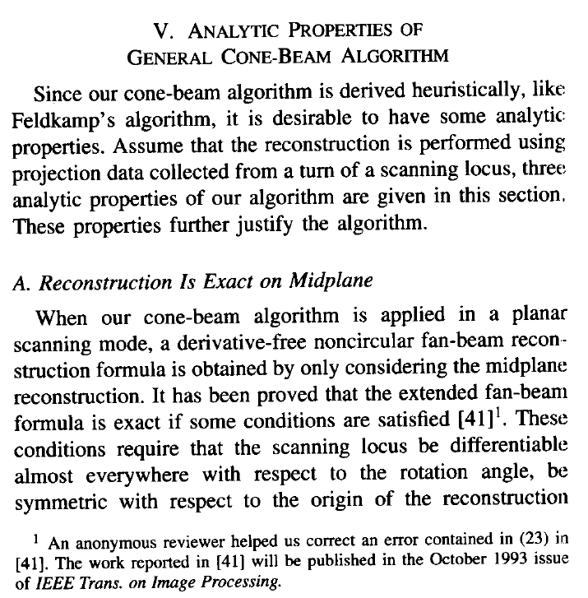
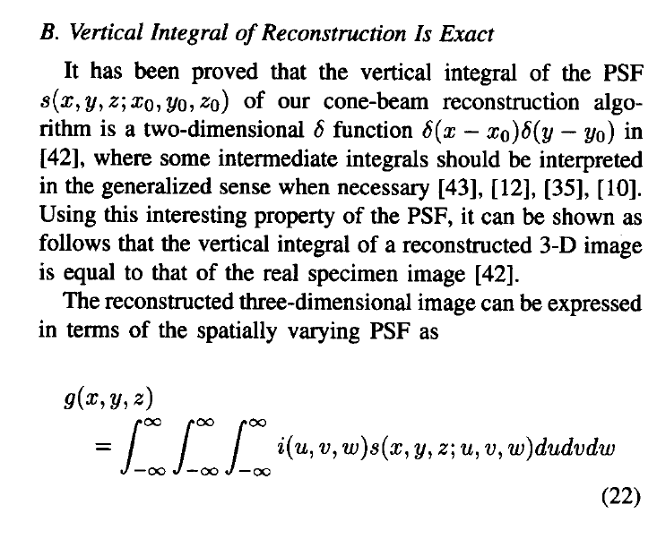

Slide 40
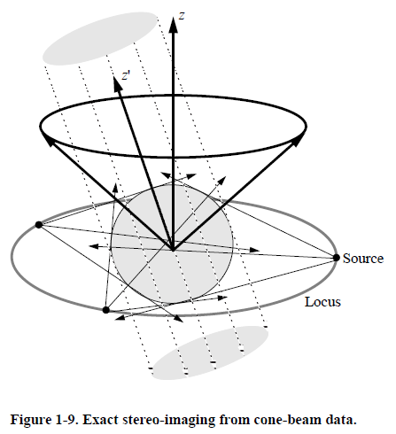
Exact Stereo-gram Synthesis
z
y
y’
z’
x’
x
G. Wang, S. Y. Zhao and P. C. Cheng, “Exact and approximate conebeam x-ray microtomography” Focus on Multidimensional Microscopy, vol. 1, ed P C Cheng, P P Huang, J L Wu, G Wang and H G Kim (Singapore: World Scientific) chapter 1, pp 233–261, 1999
https://ieeexplore.ieee.org/document/4179791/

Slide 41

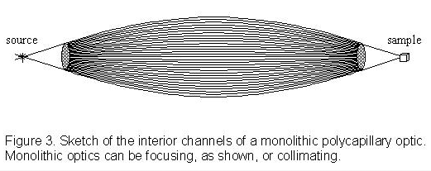
Bend X-rays?

Slide 42
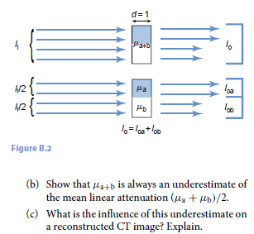
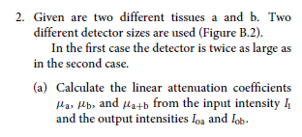
Homework

Slide 43
Homework
Review the Key Ideas for Recon with 2D Planar or Parallel-beam Data (Two Fourier Slice Theorems in 3D, Orlov Condition)
Optional: Write One Page Explaining the Grangeat Relationship
https://www.uni-muenster.de/AMM/num/Preprints/1998/natterer_1/paper.html/node16.html
https://link.springer.com/chapter/10.1007/BFb0084509

